Slide 1
Knowledge Reuse for Design of a Complex System
S3 Progress Presentation
by Wendi Ding
Tutors: Juan José Montero Jimenez,
Rob Vingerhoeds

Slide 2
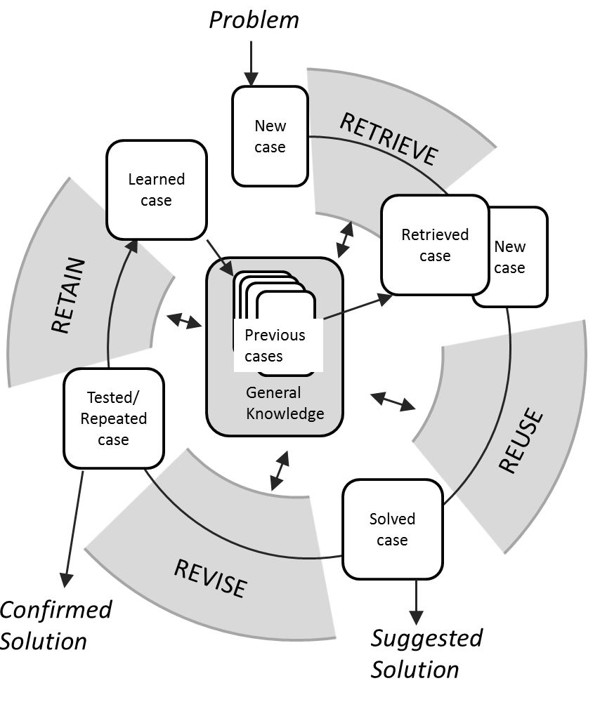
Project Introduction
Goal: Build a decision support system for complex system design using Case-Based Reasoning (CBR)
Project Issues:
Predictive Maintenance (PM) System
Redundant Cases in the Case Base
Improving Diversity of Retrieval
Case Base Maintenance (CBM) Methods
Figure 1 – CBR cycle [1]

Slide 3
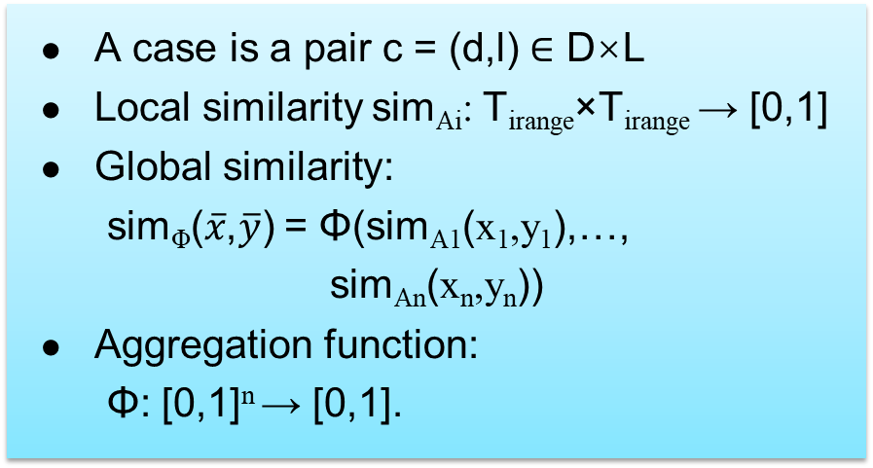
Context of Case-Based Reasoning (CBR)
- Case Representation & Similarity Assessment
A case is a pair c = (d,l) ∈ D×L
Local similarity sim_{Ai}: T_{irange}×T_{irange} → [0,1]
Global similarity:
sim_{Φ}($\overline{x}$,$\overline{y}$) = Φ(sim_{A1}(x₁,y₁),…,
sim_{An}(x_{n},y_{n}))
Aggregation function:
Φ: [0,1]^{n} → [0,1].
Attribute-Value Representation
Object-Oriented Representation
Graph Representations
Predicate Logic Representation
Unordered symbolic attributes
- Tabular similarity measures
- Taxonomies
String attributes
- EQUALITY
- NGRAM
- LEVENSHTEIN mode
Figure 1 - General CBR cycle [1]

Slide 4
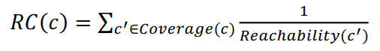
State of Art
3 Performance Goals of Case Base Maintenance (CBM) [2]
Efficiency
Competence
Solution Quality
Reduce case base size → Improve diversity ?
Case addition strategies
Case deletion strategies
Random Addition
Condensed Nearest-Neighbour (CNN) Algorithm
RC-CNN (Relative Coverage) [3]
CM-CNN (Competence Mertric)
Random Deletion
Ironically
Utility Deletion (UD)
Deletion based on redundancy & inconsistency
Deletion based on CB size and density
Footprint Deletion [4]
Footprint Utility deletion

Slide 5
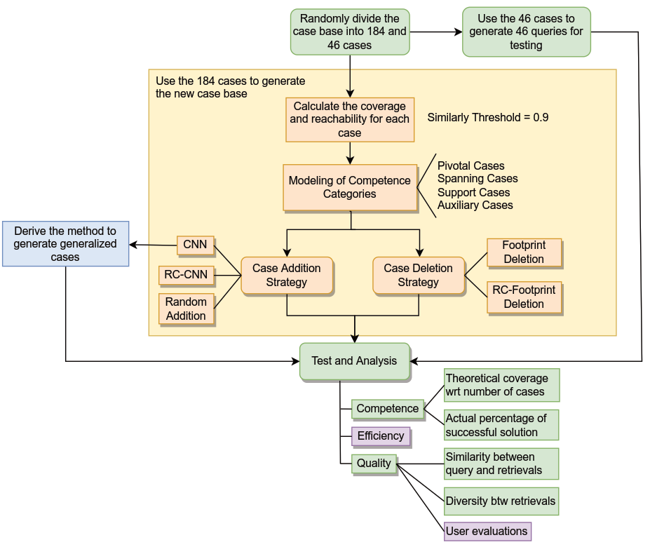
Investigation Methods
Testing Flowchart of CBM methods
- representative assumption

Slide 6
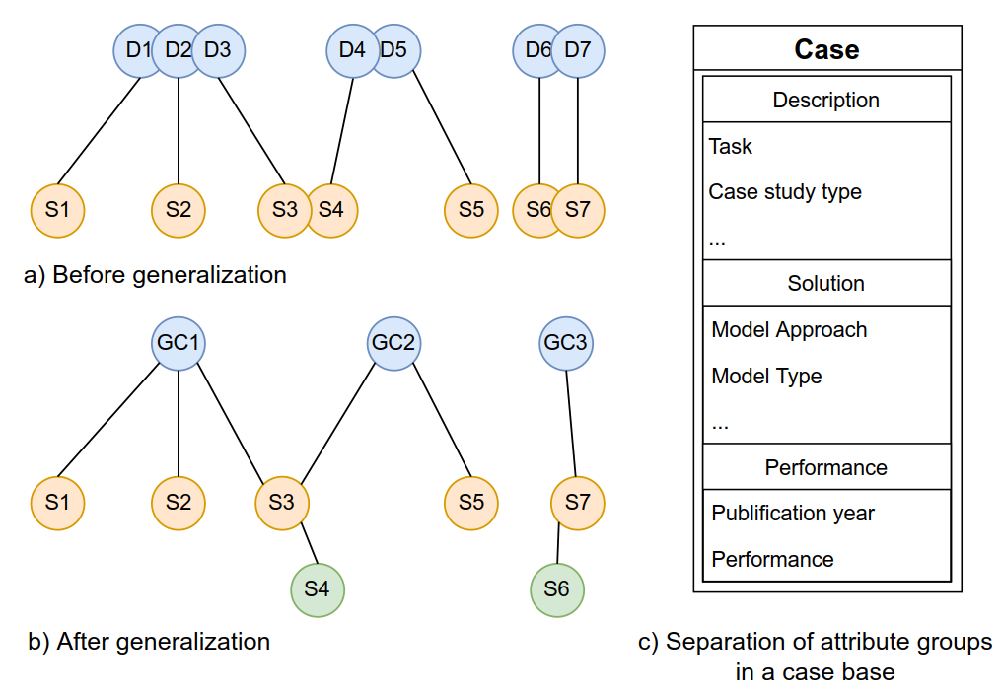
Generalization & Abstraction – Modified CNN
Separation, reindexing and generalization
Description space and solution space
Memory structure of 2 layers
Figure 2 – Separation of solution and description spaces and generalization of the case base

Slide 7
Generalization & Abstraction – Modified CNN
Steps
Separate a Case into two parts: Description part and Solution part connected to each other.
Generalization of Solutions → choose one representative with higher performance as parent
Reconnect the Description and Solution
Generalization of Descriptions → merge the descriptions to form Generalized Cases (GC)
Reconnect GC and its corresponding Solutions
Figure 2 – Separation of solution and description spaces and generalization of the case base

Slide 8
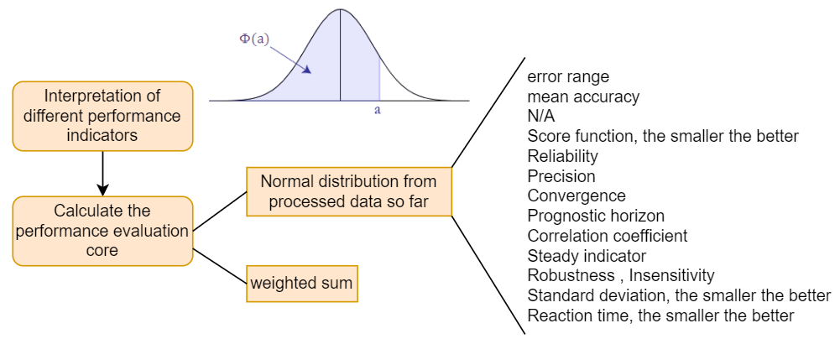
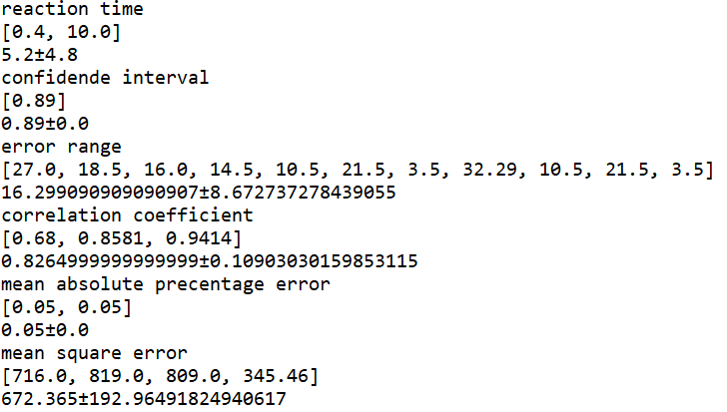
Performance Evaluation for Solutions
Normal distribution + weighted sum
- A look-up table for the probability calculation
s
Figure 3 – The calculation of performance evaluation metrics

Slide 9
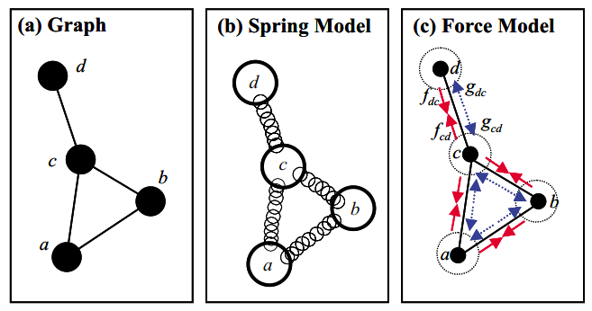
Case Base Visualization (CBV)
Force-Directed Graph-Drawing Algorithm
Map the n-dimensional cases onto a two-dimensional screen
Preserving the similarity relationships between pairs of cases as on-screen distances.
Pearson’s correlation coefﬁcient & Spearman’s rank correlation coefﬁcient
The CBV method of Force-Directed Graph-Drawing is applied in vpython to demonstrate intuitively the case distribution in the case base to the user and to show the effects of Modified CNN method on diversification of retrievals compared with original CNN method.
Figure 4 – The Force-Directed Graph-Drawing algorithm [5]

Slide 10
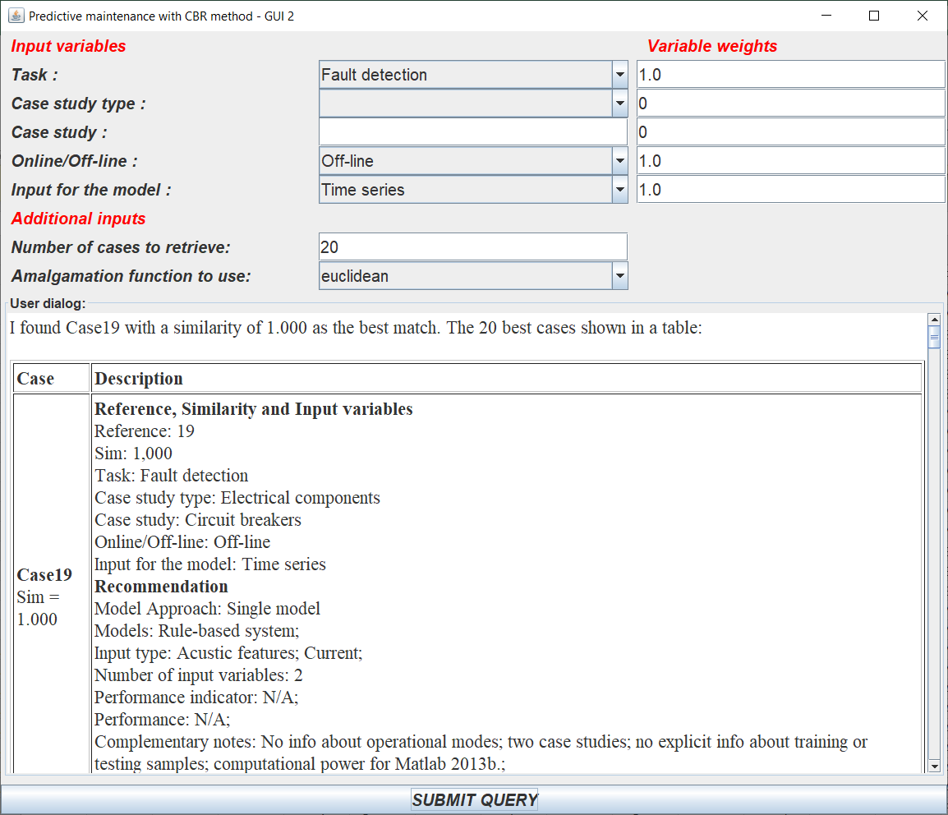
Tools of Implementation
myCBR & SDK
Java-based, open-source similarity-based retrieval tool
Software Development Kit (SDK) has limited customizability
Predictive Maintenance case base of 230 cases
Xml files
Vpython
Case Base Visualization (CBV) for case base and retrieval results inspection
Figure 6 - Example of a myCBR application

Slide 11
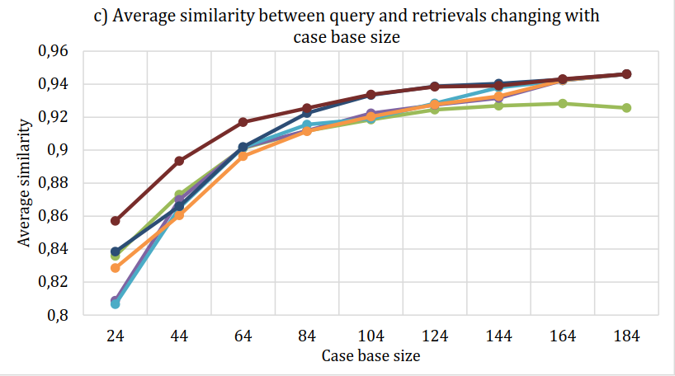
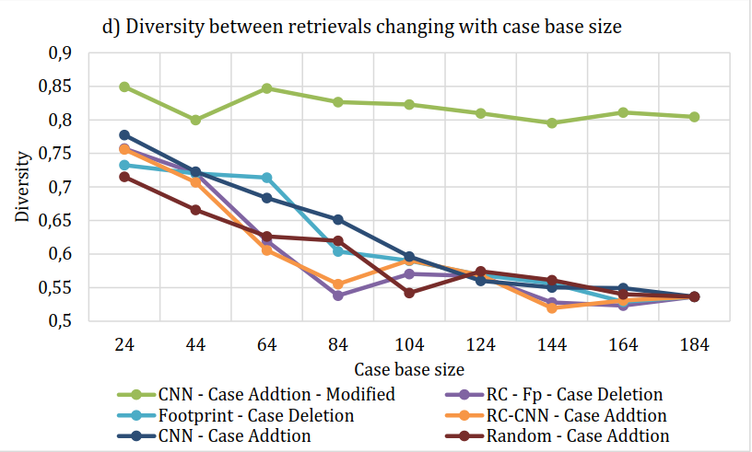
Results & Analysis
Reduce case base size → Improve diversity ?
Figure 7 – Statistical testing results of different CBM methods: c) Similarity between query and retrieved descriptions and d) Diversity between retrieved solutions with regard to different predefined reduced case base sizes. The Modified CNN method is tested with a description generalization threshold $θ_{des}$=1.2 and a solution generalization threshold of $θ_{sol}$=0.75
For competence-preserving CBM methods, retrieval diversity is improved linearly with the reduction of case base size.
The generalization of solutions introduces a significant increase in diversity (by up to 45% percent) not changing with the case base size.

Slide 12
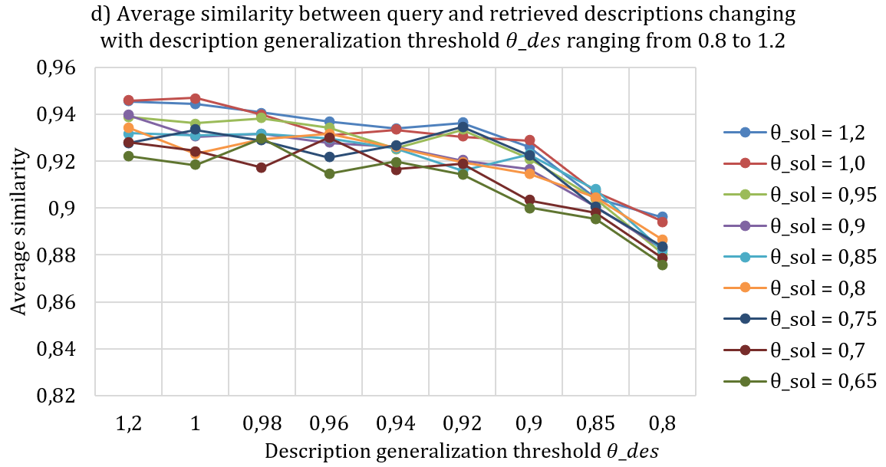
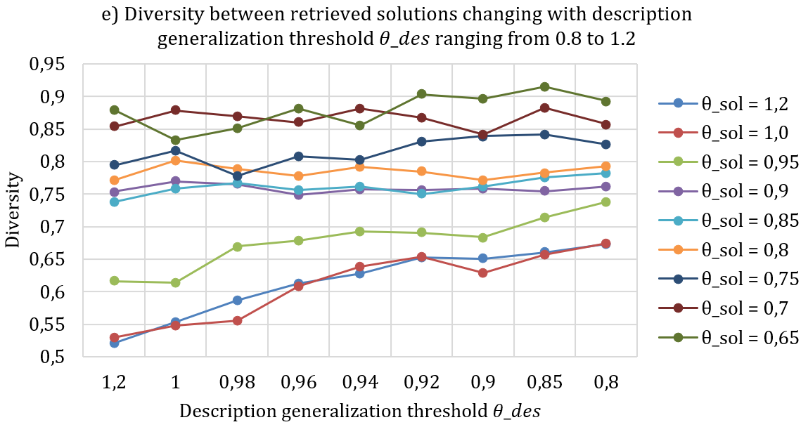
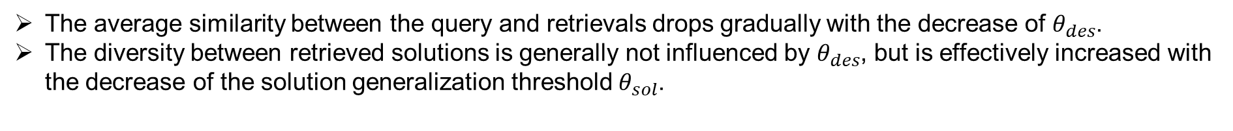
Results & Analysis
Figure 8 – Statistical testing results of the Modified CNN method: d) Similarity between query and retrieved descriptions and e) Diversity between retrieved solutions with regard to different threshold for descriptions $θ_{des}$ranging from 0.8 to 1.2 (no generalization).
The average similarity between the query and retrievals drops gradually with the decrease of $θ_{des}$.
The diversity between retrieved solutions is generally not influenced by $θ_{des}$, but is effectively increased with the decrease of the solution generalization threshold $θ_{sol}$.

Slide 13
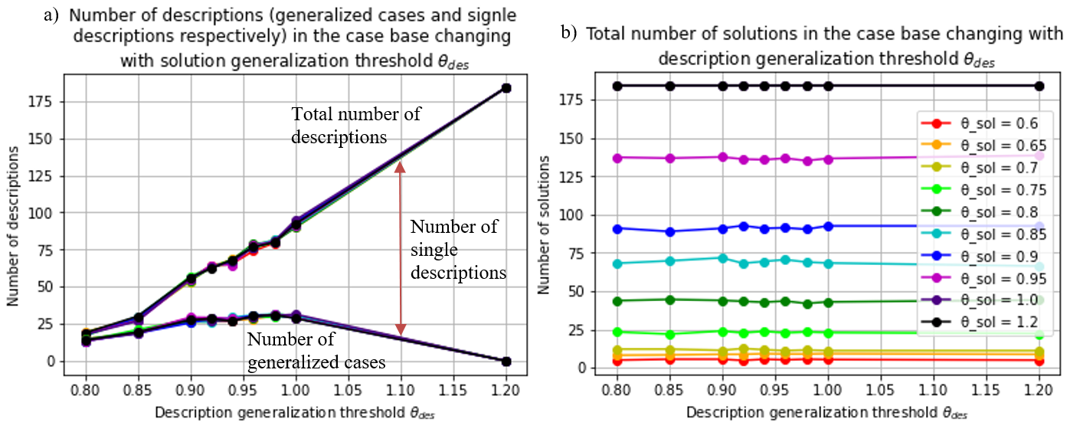
Results & Analysis
Figure 9: Case base statistics of the Modified CNN method: a) Number of descriptions (generalized cases and single descriptions respectively), b) Total number of solutions in the case base, and d) Number of solutions of the two layers in the case base with regard to different threshold for solutions $θ_{sol}$ranging from 0.6 to 1.2.
a clear separation of descriptions and solutions
the process of generalization with the increase of description and solution generalization thresholds

Slide 14
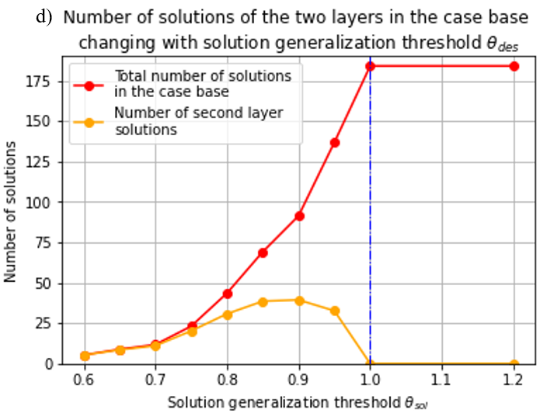
Results & Analysis
Figure 9: Case base statistics of the Modified CNN method: a) Number of descriptions (generalized cases and single descriptions respectively), b) Total number of solutions in the case base, and d) Number of solutions of the two layers in the case base with regard to different threshold for solutions $θ_{sol}$ranging from 0.6 to 1.2.
a clear separation of descriptions and solutions
the process of generalization with the increase of description and solution generalization thresholds

Slide 15
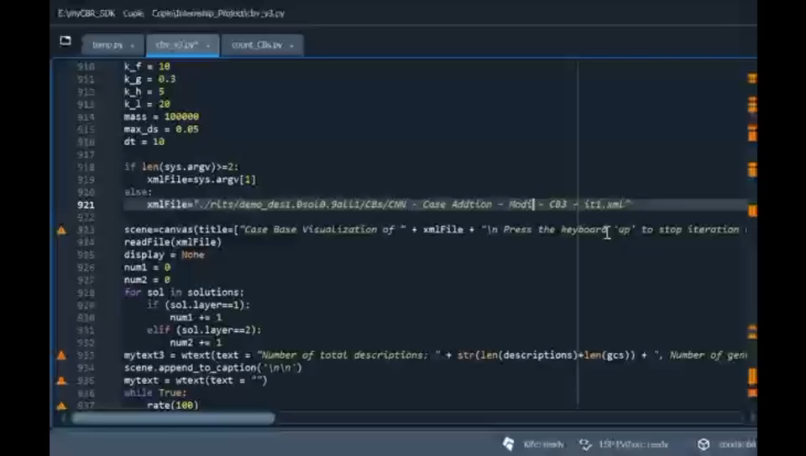
Results & Analysis – Case Base Inspection

Slide 16
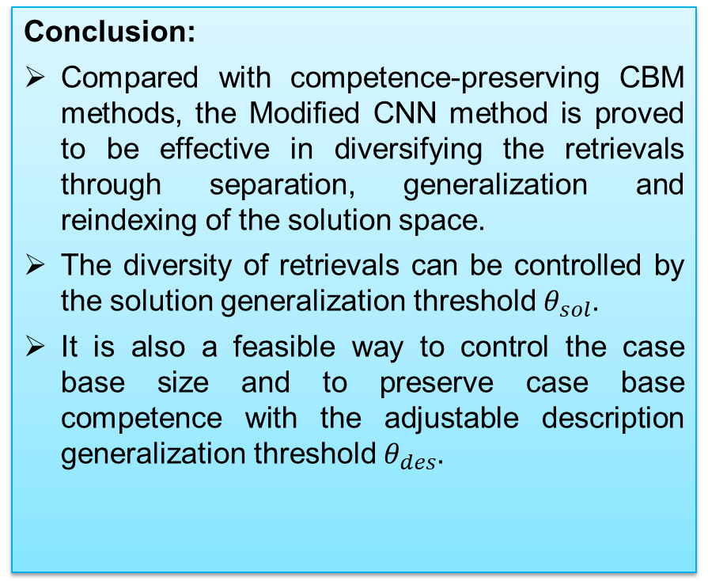
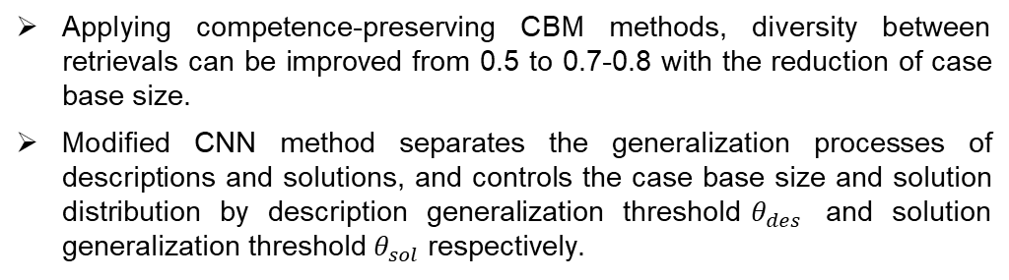
Conclusion & Perspectives
Conclusion:
Compared with competence-preserving CBM methods, the Modified CNN method is proved to be effective in diversifying the retrievals through separation, generalization and reindexing of the solution space.
The diversity of retrievals can be controlled by the solution generalization threshold $θ_{sol}$.
It is also a feasible way to control the case base size and to preserve case base competence with the adjustable description generalization threshold $θ_{des}$.
Future perspectives:
In order to maximize the competence of the case base, the modification could be applied to more advanced methods such as RC-CNN method.
The CBM methods should be compared with diversification methods that focus on the retrieval process such as Bounded Greedy Selection (BGS).
Performance functions should be updated with the evolution of the case base. It would also be interesting to integrate the publication year into the performance evaluation calculation.
The constants in the Force-Directed Drawing-Graph Algorithm still need to be studied to find the best combination of them.
Applying competence-preserving CBM methods, diversity between retrievals can be improved from 0.5 to 0.7-0.8 with the reduction of case base size.
Modified CNN method separates the generalization processes of descriptions and solutions, and controls the case base size and solution distribution by description generalization threshold$θ_{des}$ and solution generalization threshold$θ_{sol}$ respectively.

Slide 17
Thank you！

Slide 18
Bibliography
[1] | R. Bergmann, “Experience Management: Foundations, Development Methodology, and Internet-Based Applications”, Lecture Notes in Computer Science, 2432. Springer, 2002.
[2] | M. K. Haouchine et al., “Case Base Maintenance Approach”, International Conference on Industrial Engineering and Systems Management, 2007.
[3] | B. Smyth, Barry, and E. McKenna, "Building compact competent case-bases", In International Conference on Case-Based Reasoning, pp. 329-342. Springer, Berlin, Heidelberg, 1999.
[4] | B. Smyth and M. T. Keane, “Remembering to forget: a competence-preserving case deletion policy for case-based reasoning systems”, In Proceedings of the 14th international joint conference on Artificial intelligence, vol. 1, pp. 377-382, 1995.
[5] | B. Smyth et al., “Picture perfect - visualisation techniques for case-based reasoning”, In Proceedings of the 14th European Conference on Artificial Intelligence, IOS Press, NLD, pp. 65-69, 2000.

Slide 19
Contents
Project & Context Introduction
State of Art
Investigation Methods
Results & Analysis
Conclusion & Perspectives

Slide 20
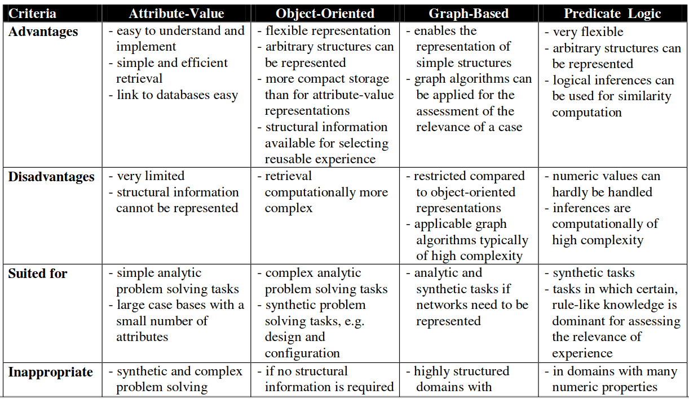

Slide 21
Project Introduction
Goal: Build a decision support system for complex system design using Case-Based Reasoning (CBR)
Project Issues:
Predictive Maintenance (PM) System
Case Representation & Similarity Assessment
Improving Diversity of Retrieval
Case Base Maintenance Methods
Diversification by Elimination
The Bounded Greedy Selection (BGS) algorithm (Quality Metrics)
Abstraction & generalized cases
Figure 1 – CBR cycle

Slide 22
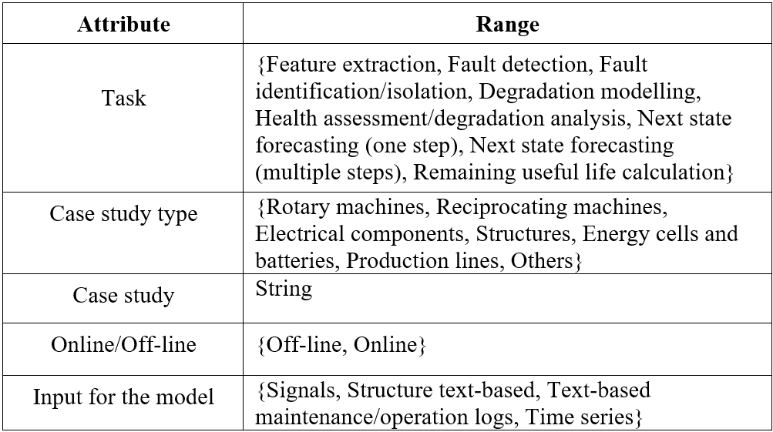
Attributes in Description Space
Predictive Maintenance Case Base
Attribute-Value Representation
19 attributes to describe each case
5 attributes in description space
6 attributes in solution space

Slide 23
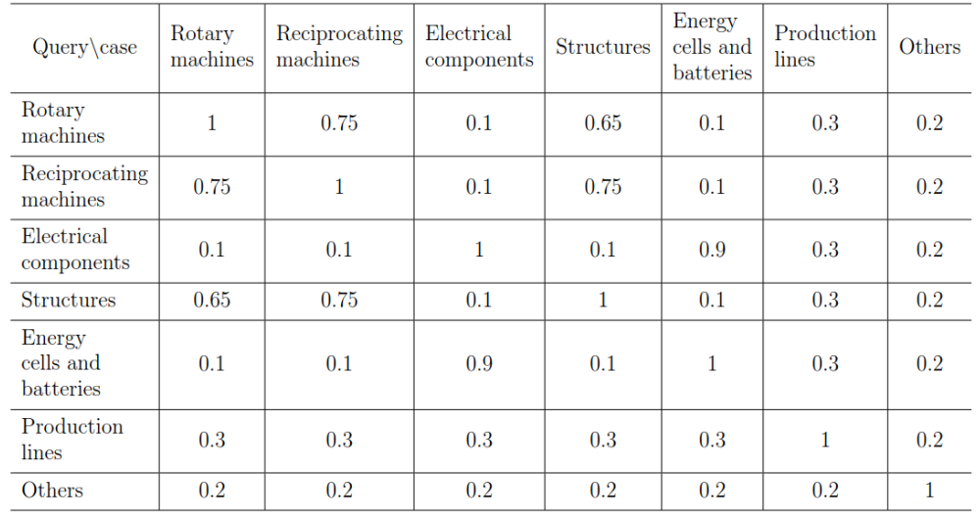
Attributes in Description Space
Predictive Maintenance Case Base
Attribute-Value Representation
19 attributes to describe each case
5 attributes in description space
6 attributes in solution space

Slide 24
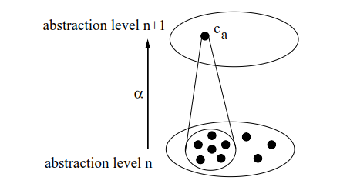
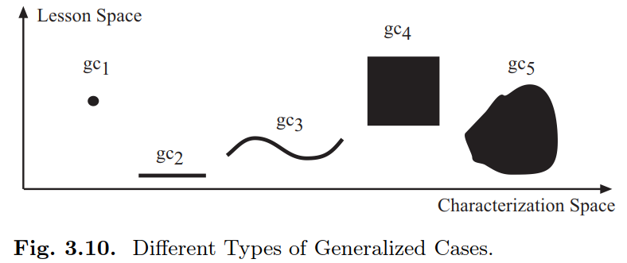
Generalized Cases
A projection to a subset of the attributes
Removing less significant ones.
Several levels (or layers) of abstraction
To reduce the size of the case base.
Figure 3: Different Types of Generalized Cases [5]
Figure 4: Abstraction and generalization [6]
Point case (gc1)
Constant lesson (gc2)
Functional lesson (gc3)
Independent alternative lessons (gc4)
Dependent alternative lessons (gc5).

Slide 25
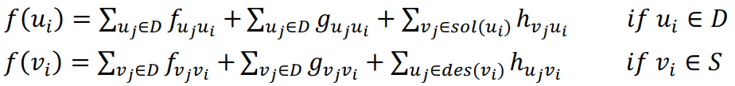
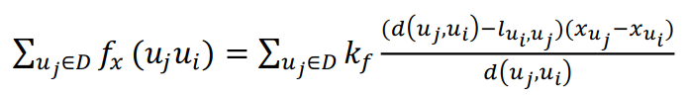
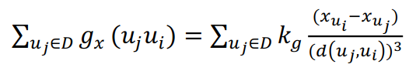
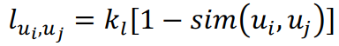
Case Base Visualization (CBV)
Pearson’s correlation coefﬁcient & Spearman’s rank correlation coefﬁcient
Figure 4 – The Force-Directed Graph-Drawing algorithm [5]

Slide 26
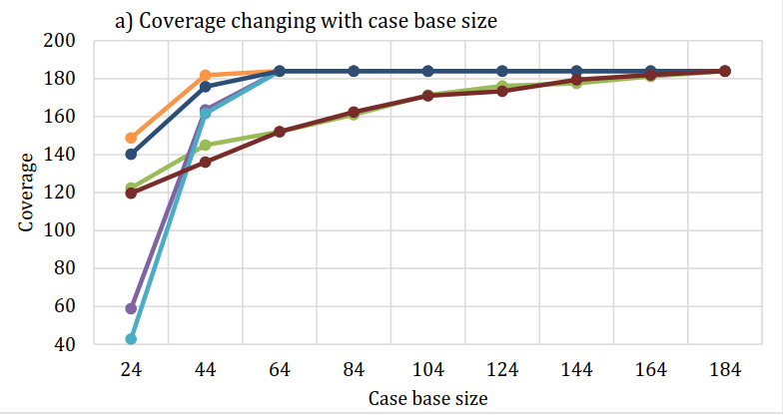
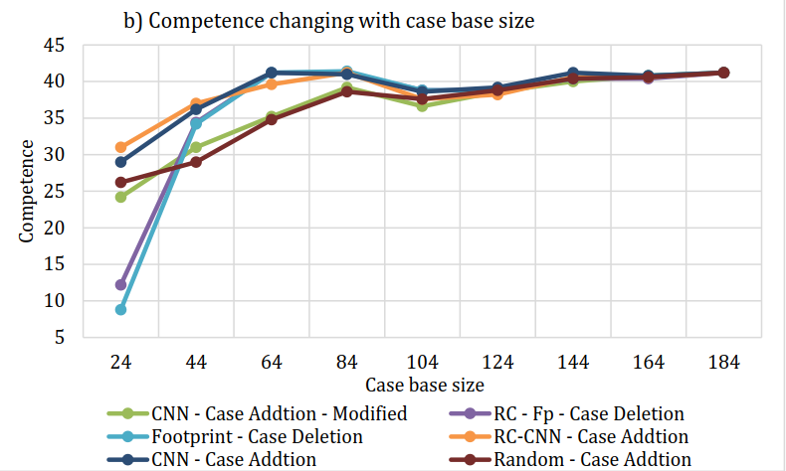
Results & Analysis
Figure 7 – Statistical testing results of different CBM methods: a) Case base coverage, b) Case base competence with regard to different predefined reduced case base sizes. The Modified CNN method is tested with a description generalization threshold $θ_{des}$=1.2 and a solution generalization threshold of $θ_{sol}$=0.75
Competence-preserving CBM methods can effectively preserve case base coverage and competence while reducing case base size (by up to 65.2%).
The curve of Modified CNN method resembles that of Random Addition method.

Slide 27
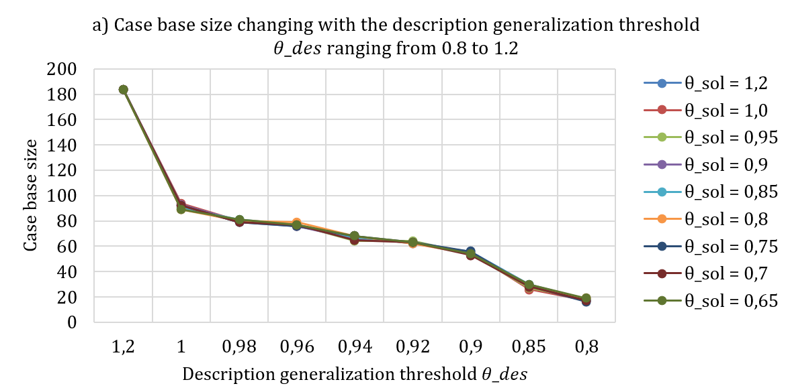
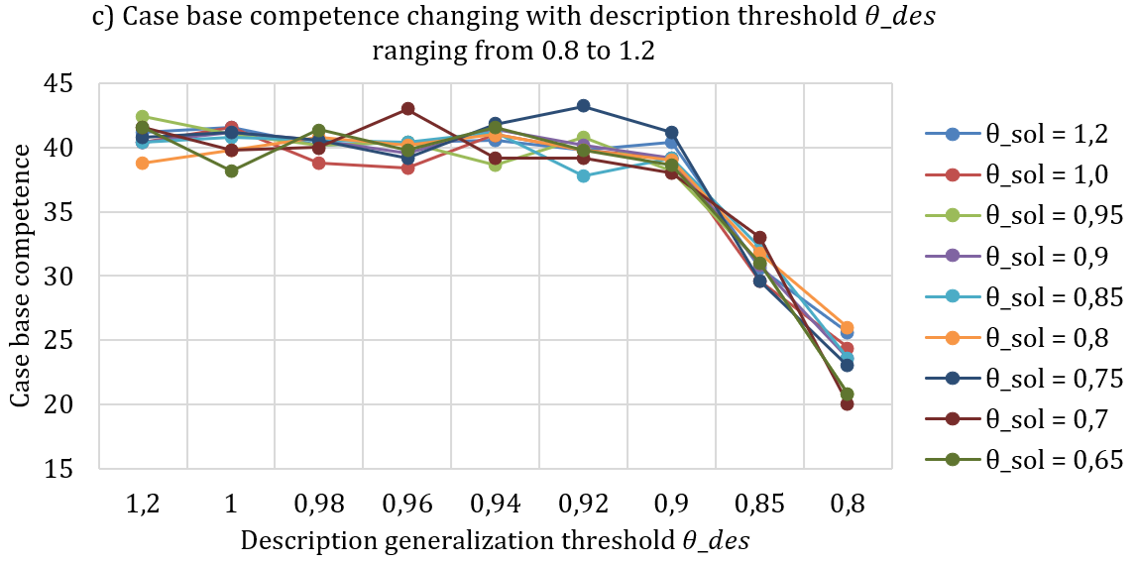
Results & Analysis
Figure 9 – Statistical testing results of the Modified CNN method: a) Case base size, c) Case base competence with regard to different description generalization thresholds $θ_{des}$ranging from 0.8 to 1.2 (no generalization).
Case base size is reduced with the decrease of description generalization threshold$θ_{des}$.
The generalization of solutions does not have a significant effect on the case base competence.

